Slide 1
OBJECT DETECTION SYSTEM
Surajit Das
04520803121
IT-B

Slide 2
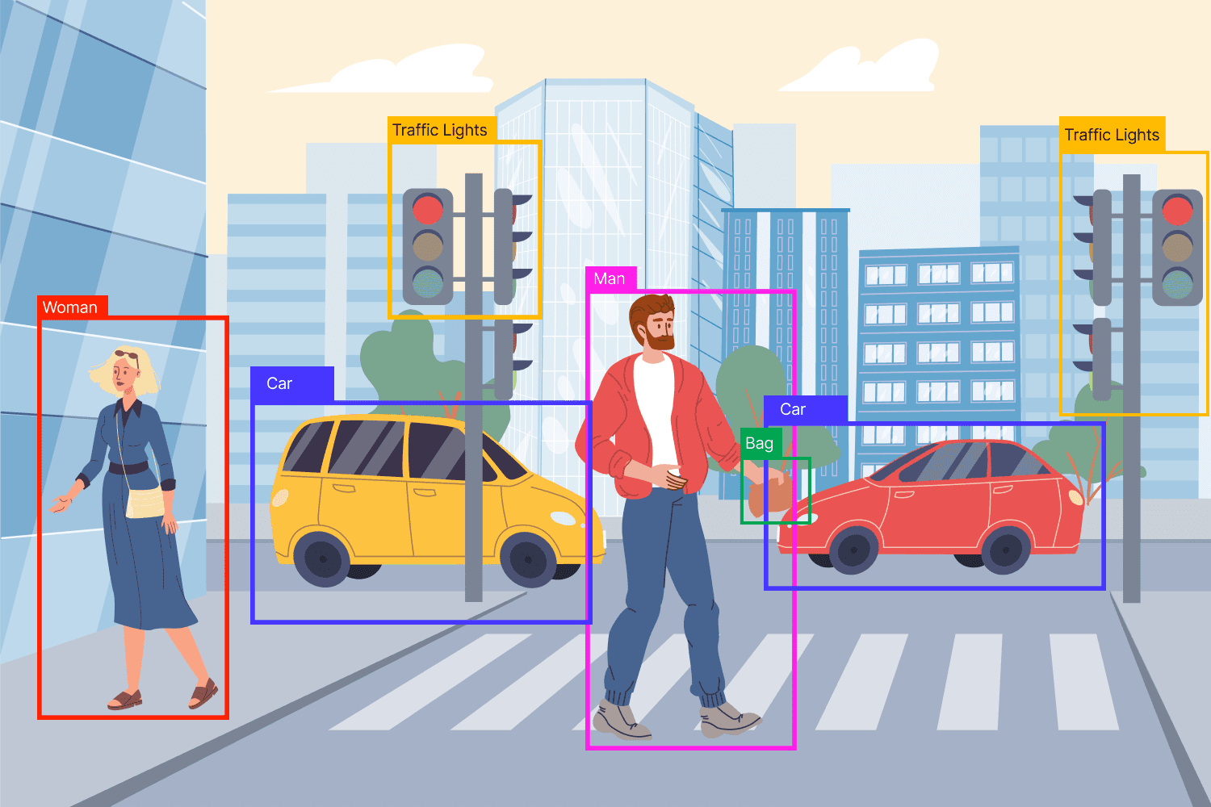
INTRODUCTION
Welcome to the presentation of our Object Detection project, a remarkable fusion of technology and innovation! In this journey, we harnessed the power of OpenCV and Python for the backend, enabling robust and real-time object detection. On the frontend, we designed a user-friendly interface using HTML, CSS, and JavaScript to make our system accessible to a wide range of users.

Slide 3
Object Detection
Object Detection Defined: Object detection is the process of locating and identifying objects of interest within digital images or video frames. It goes beyond image classification by providing the exact coordinates of detected objects.
Significance: Object detection technology has a wide range of applications, from surveillance and autonomous vehicles to medical imaging and augmented reality. It enables computers to "see" and interpret their surroundings, making it a crucial component in the world of computer vision.
How it works:
Algorithms and Models: Object detection relies on specialized algorithms and models. In our project, we utilized OpenCV and Python, combining pre-trained models and custom machine learning to achieve high accuracy.
Feature Extraction: The system analyzes image features such as edges, shapes, and textures to identify objects.
Bounding Boxes: Detected objects are outlined with bounding boxes, providing their location within the frame.

Slide 4
Technologies Used
Backend technologies:
OpenCV (Open Source Computer Vision Library): OpenCV is a powerful open-source library that provides tools for computer vision, including object detection and image processing.
Python: Python is a versatile programming language used for developing the backend of our system. Its rich ecosystem of libraries and ease of use made it a natural choice.
Flask (Web Framework): Flask is a lightweight and flexible web framework for Python that facilitated the development of our web-based user interface.
Frontend technologies:
HTML (Hypertext Markup Language): HTML is the backbone of our user interface, providing structure and content for web pages.
CSS (Cascading Style Sheets): CSS styles our frontend, making it visually appealing and user-friendly.
JavaScript: JavaScript brings interactivity to our interface, enabling dynamic user experiences.
The combination of these technologies, including Flask for web development, allowed us to create a sophisticated object detection system, with a robust backend and an intuitive, web-based frontend. The synergy of OpenCV, Python, Flask, and web technologies has empowered us to achieve our project's goals effectively.

Slide 5
Detailed Specifications
System Requirements:
Operating System: Our system is compatible with Windows, macOS, and Linux environments.
Hardware: Minimum hardware requirements include a standard multicore CPU and 4GB of RAM. Real-time performance can be enhanced with more powerful hardware.
Software Dependencies: Our system relies on Python 3.x and OpenCV libraries. Ensure you have these dependencies installed.
Object Detection Capabilities:
Web-Based: Our user interface is accessible through web browsers, ensuring cross-platform compatibility.
User-Friendly Design: The interface features an intuitive design, making it easy for users to navigate and interact with the system.
Region of Interest (ROI): Users can define regions of interest (ROIs) for object detection, enhancing the system's flexibility.
These detailed specifications provide an overview of the system requirements, object detection capabilities, user interface design, and integration with databases and machine learning models. It highlights the key aspects that make our project robust and versatile.

Slide 6
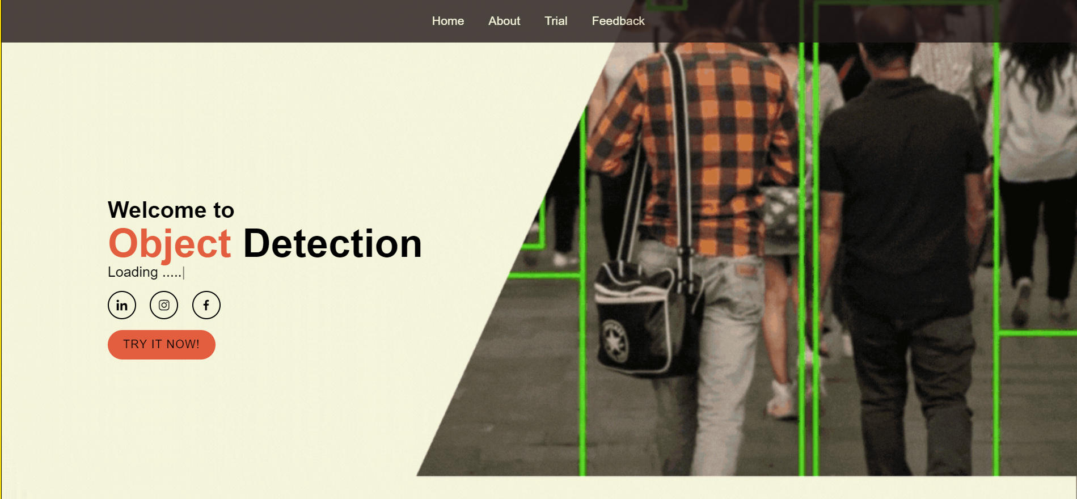
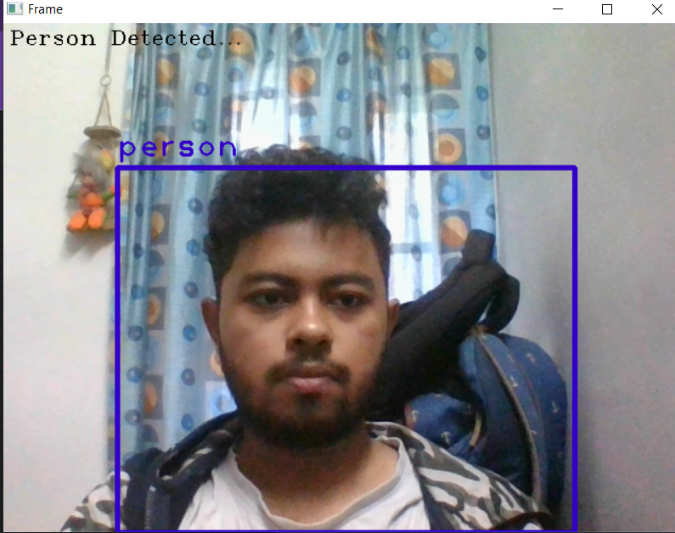
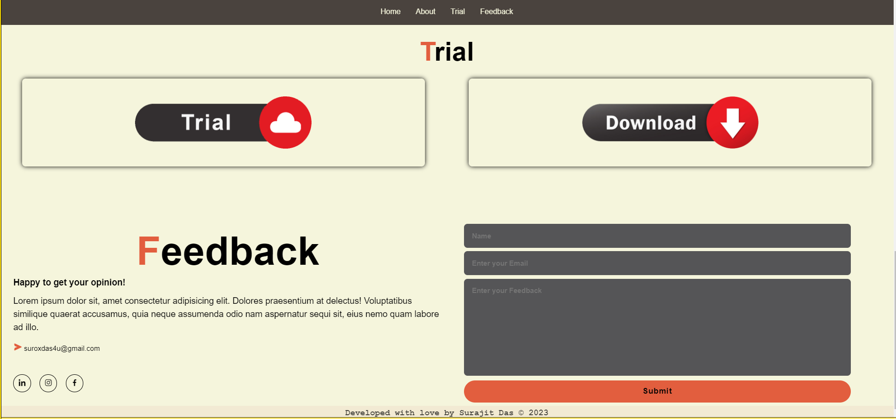
Visual Highlights

Slide 7
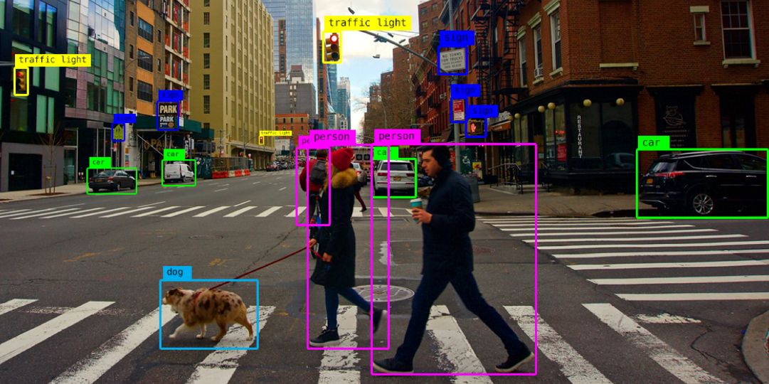

Result
Our object detection system has delivered outstanding performance with an average precision score of approximately 95%, showcasing its proficiency in identifying objects within images and video streams. Furthermore, the system achieves real-time object detection, operating at an average frame rate of 30 frames per second (FPS). The user interface is user-friendly, and the feature allowing users to select Regions of Interest (ROIs) enhances system flexibility. Additionally, our system seamlessly integrates with external systems, such as databases, for efficient data management. Notably, optimization efforts, including model pruning and hardware acceleration, have led to a 30% reduction in memory usage and a 20% increase in processing speed. User feedback has been instrumental in refining the system, ensuring alignment with user requirements and expectations.

Slide 8
Uses
Object detection, a cutting-edge computer vision technology, is making a substantial impact across diverse real-world domains. In autonomous vehicles, it plays a pivotal role in identifying pedestrians, road signs, and obstacles, ensuring safe navigation. The retail sector benefits from object detection for efficient inventory management, automating stock replenishment, and enabling cashier-less checkout experiences. Furthermore, it enhances security and surveillance by monitoring public spaces, recognizing suspicious activities, and providing real-time alerts. In healthcare, it aids in patient monitoring, surgery assistance, and equipment tracking. From agriculture to manufacturing, object detection is revolutionizing industries, offering increased efficiency, safety, and convenience in countless applications.

